Slide 2
Notes:
This project was started to education students on borrowing. And it seems we could have not created it at a better time with the proposed Gainful Employment Rule. Students are borrowing more than ever before, through discussions with people in the sector we believe it is because many students seem to be lacking knowledge in financial aid. Many are borrowing more than they can manage and do not realize the long-term impact of borrowing. We hope our Financial Planning Made Simple tool will help students make responsible financial decisions.

Slide 3
Notes:
The Financial Planning Made Simple tool is an online-based animated avatar video which walks students through the budgeting, borrowing and repayment process. Include in the video is a downloadable student financial planning calculator. Our calculator is different than what is already out in that we combined the budgeting and borrowing calculators into one.

Slide 4
Notes:
Students will have the choice to choose between a male and female avatar to walk them through the process.

Slide 5
Notes:
To create his budget Jorge identifies his expenses and identifies his income. To create as little debt as possible it is important to identify your needs and wants.

Slide 6
Notes:
Many career colleges students are older, married, and have children. We decide to include two different budgeting scenarios, 1 for students who live with their family who most likely pay the rent and utilities bills. The second scenario is for students who live on their own and pay all their bills.

Slide 7
Notes:
While Jorge is figuring out his budget he realizes that he is spending more than he is bring in. He decides he must work part time and go to school to lover his budget surplus. In addition to working part-time, he re-evaluates his budget and cuts out his wants such as cable and gym membership.

Slide 8
Notes:
Throughout the video the avatars visit with their financial aid advisors where they learn more about federal financial aid and the repayment process. Students are able to click on the different terms to learn more about them. Also during the video students are able to download the “Student Financial Planning” tool which is exactly the same as in the video. The student can follow along with the avatars or use the tool on their own later.

Slide 9
Notes:
Here Renee meets with her financial aid advisor to learn more about the different repayment options and other important terms such as consolidation, forbearance, deferment and default.

Slide 10
Notes:
Renee decides to look at her options, 1: no job, no optimizing 2: with a job and economizing 3: student loan expenses only. The total loan amount for no job, no optimizing Renee would have to take out a loan for $63,000, with standard repayment the monthly payment would be $687, total interest charged would be $19,421, making the total loan repayment would be $82,421.

Slide 11
Notes:
Student’s can download the “Student Financial Planning” calculator tool and use it to plan their budget and figure out how much they can borrow.

Slide 12
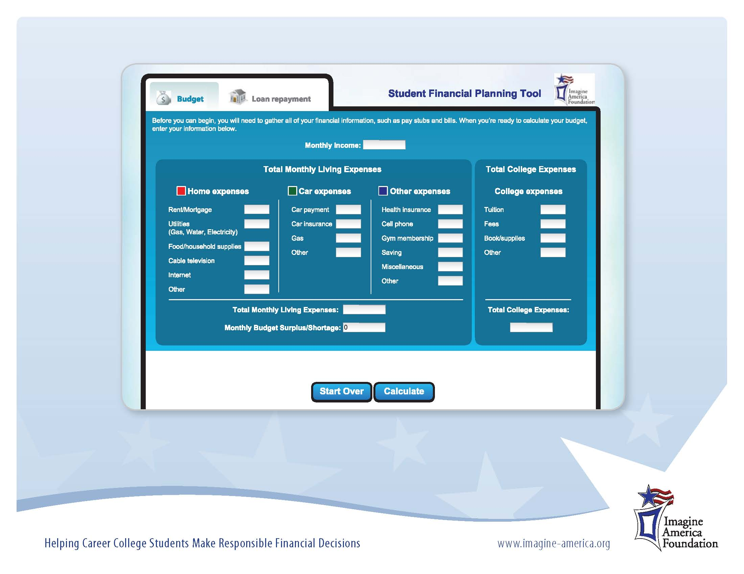
Notes:
When the student enters in their numbers and selects calculate different pop ups come up. If there is a budget shortage the pop-up tells the student to re-evaluate there budget. With a small budget surplus the student is advised to eliminate any wants to add to their savings incase of an emergency. With a budget surplus they are advised to put extra in to savings.

Slide 13
Notes:
The FPMS tool will be available to current participating colleges, as an additional benefit to enrolling in the scholarship and award programs. Participating colleges will have access to FPMS and starting in March it wil be required that all Imagine America recipients complete the FPMS video in order to receive their award.
Participating colleges will have a username and password to log in, as a result, non-Imagine America recipients can have access to the tool through the college. The Foundation will track which of our recipients have completed the FPMS tool. By doing this we hope to be able to track default rates of these students and compare them to the average of career college students in 2 to 3 years.

Slide 14
Notes:
Our Financial Planning Made simple tool is specifically for career colleges students. This engaging tools is unlike an thing else in the market. Many of the students who demoed the tool liked the simplicity of it and said it made budgeting and financial aid easy to understand.

